Slide 1
The fastai API and You: Applying a New and Improved Flexible Framework to Help Solve Deep Learning Challenges
By Zachary Mueller

Slide 2

Who am I?
A leading expert in the fastai framework
One of the community leaders for fastai
Undergraduate at the University of West Florida
Major in Software Design and Development with a minor in Environmental Science

Slide 3
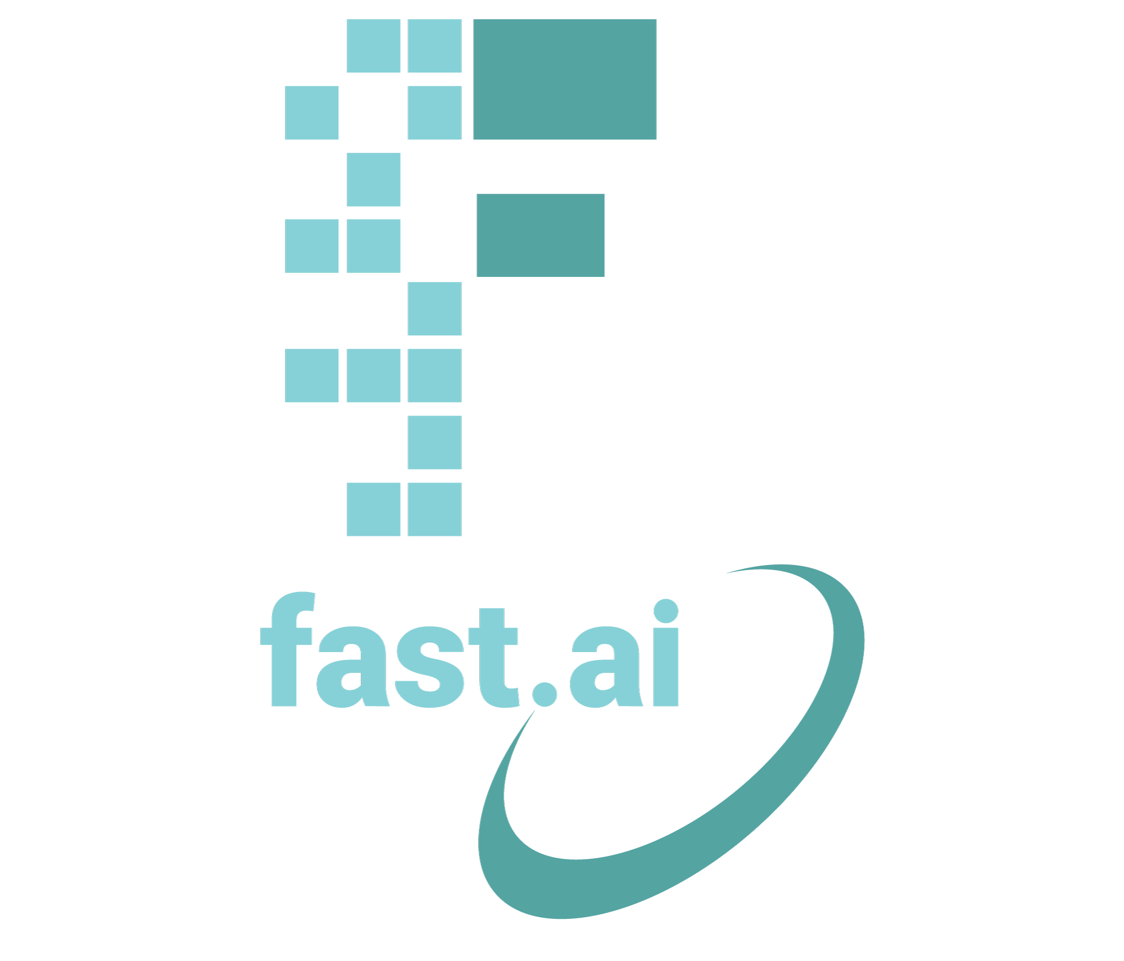

What is fastai?
A company (Fast.AI)
A framework (fastai)
A series of courses
A paper
A book
A community
Jeremy Howard & Sylvain Gugger (formally)

Slide 4
What is the goal?
“To make neural networks uncool again”
Allow state-of-the-art to be accessible to all
Bring the world of Machine and Deep Learning across any domain so it can be used as a tool in furthering ingenuity

Slide 5
Teaching Methodology and Current Courses
A Top-Down approach rather than Bottom-Top
Allows for small successes quickly, while inviting room to grow
Courses:
Deep Learning for Coders with fastai and PyTorch: AI Applications Without a PhD
Computational Linear Algebra
Natural Language Processing
Ethics in AI

Slide 6
Leaning Into the Bleeding Edge of Research
Testing and experimentation is encouraged throughout the course
Notable ideas popularized by Jeremy and the students:
Transfer Learning across more than just Computer Vision
Dynamic Unet by Kerem Torgutlu during the course
Notable integrations:
Test-Time Augmentation
Learning rate finder
MixUp data augmentation
SOTA Optimizers

Slide 7
The Framework

Slide 8
The Software Stack
fastai
PyTorch
Python

Slide 9
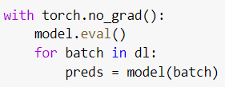

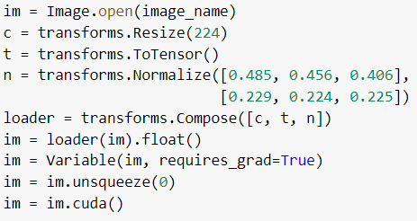

What Does It Mean to Run on PyTorch?
The annoying parts are optimized and simplified:

Slide 10
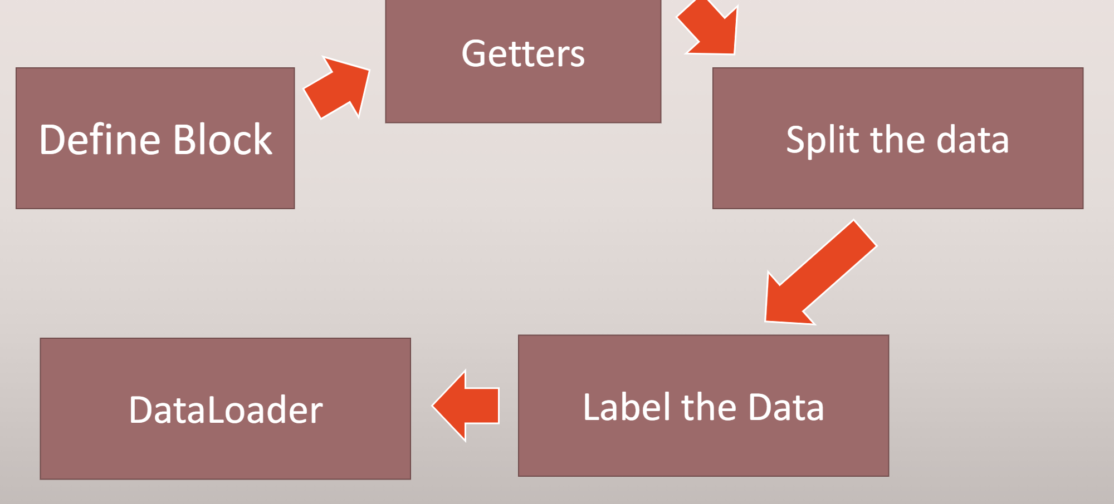
A Layered API
Full customizability at any level with the same pattern in any domain

Slide 11
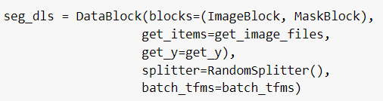
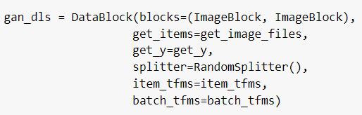
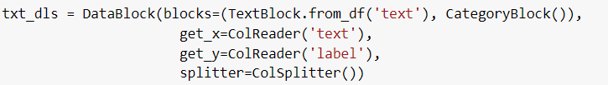
Let’s view few examples:

Slide 12
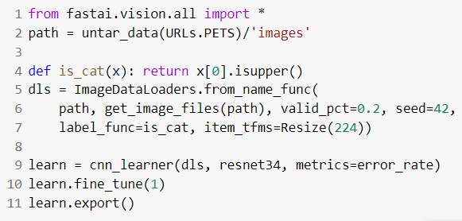

Simplifying the Entire Pipeline
Training
Deployment
Note: This code is borrowed from Jeremy and Sylvain’s book

Slide 13
Why So Much Magic?
Default parameters were found through experimentation and looking for common trends
Easier to go from start to finish without much trouble with standard problems
You can remove most of fastai’s magic the further down you go
One example is using a PyTorch DataLoader and Model and only training in the fastai framework

Slide 14
It Can’t Really Be That Simple, Right?
We will walk through two examples:
Image Classification
Tabular Binary Classification
Further Resources:
fastbook
My course notebooks
Walk with fastai
Forums

Slide 15
Acknowledgements
UWF’s AI and Data Analytics Research Group
Dr. Bagui
Jeremy Howard, Rachel Thomas, and Sylvain Gugger
The entire fastai and Deep Learning community

